Slide 2
玩个时间测试游戏：
如果可以选择，您想要每一天都可以拥有多少时间来做自己喜欢的事情？（名字 ，时间）
您看电视、陪孩子玩、去看父母的时间、陪老公一起购物 ….. 有多少？（平均每一天）
目前您可以挤出来的时间是多少？ （平均每一天）
5 个小时
4 个小时
3 个小时
2 个小时
45 分钟
半个小时
15 分钟
完全不能

Slide 3
You HAVE to USE IT! It is not an OPTION!
There are 86400 sec in a day,
There are 1440 min in a day
There are 24 hours in a day
There is no Pauses, no Refund, no Returns or Bonus when it comes to TIME.
We all have equal amount of TIME regardless of FINANICAL OR SOCIAL STATUS.
It is LIMITED to our LIFESPAN!

Slide 5
Time Management is an Illusion Self Management is the FOCUS.

Slide 6
Concept of Significance Time

Slide 7
Time Management CALCULATION
（紧急）Urgency: How SOON does it matters?
（重要）Importance: How MUCH does it matters?
（意义）Significance: How LONG is it going to matters?

Slide 8
Significance Calculations
You multiply your time by giving yourself the EMOTIONAL PERMISION to spend time on things TODAY that will give you more time TOMMORROW.
先苦后甜
一分耕耘、一分收获
Notes:
This is how multipliers think

Slide 9
What I can do today that would make tomorrow better? What can I do right now that would make that future better?
Return on Time Invested ( ROTI )

Slide 10
How are we Using our TIME in MA?

Slide 12
7 Hours - Sleeping
1 Hour – Bathing, Grooming, Dressing, Etc…
8 Hours Total
8 Hours

Slide 13
2 Hours - Eating
1 Hour – Socializing
4 Hours Leisure
7 Hours Total
7 Hours
8 Hours

Slide 14
8 Hours – Job
1 Hour – Driving
9 Hours Total
9 Hours
7 Hours
8 Hours

Slide 15
24 HOURS
9 Hours
7 Hours
8 Hours

Slide 16
No Time Left for the Big things in Life!
Market America
Your Goals
Your Dreams
9 Hours
7 Hours
8 Hours

Slide 17
SIMPLE duplicatable task that can be REPEATED by a LARGE groups of people VS DIFFICULT task that can be REPEATED by a SMALL group of people
简单步骤重复做！

Slide 18
Simple Task
Duplicate
Repeat

Slide 19
每日行动 / Daily Steps
每周目标
目标阶梯：每周达到RM8,400
Goal Staircase to RM8,400/week
与5-15人谈话
订下5个约会
将10位潜在顾客加入名单
5
4
3
每日 DAILY Steps
2
1
社群媒体 Social Media
朗读目标宣言
Read Goa Statement
聆聴录音资料 Listen to Audio
与1-3人谈话 Talk/Call 1-3 pax
订下一个约会 Book 1 Appt
将2位潜在顾客加入名单
Add 2 possibilities

Slide 20
每周行动 / Weekly steps
每月目标
目标阶梯：每周达到RM8,400
Goal Staircase to RM8,400/week
与20-60人谈话
订下20个约会
将40位潜在顾客加入名单
每周目标
5
4
每周目标
3
2
1
第四周
5
4
3
每周目标
2
第三周
1
每周 / Each Week
介绍1次事业计划 Show Plan 1x
对1位事业人选进行跟进 Follow up with 1 prospect
带客人参加超连锁™创业说明会 Attend UBP With guest
增加1位新顾客 Add 1 Customer
与上线通电话Call your mentor
5
4
3
2
第二周
1
5
4
3
2
第一周
1

Slide 21
可产生效益的活动
Result Producing Activities
使用及销售产品
Use and Sell the Products
分享美安马来西亚事业
Share the Business
分享购物年金
Share the Business
销售门票（培训）
Sell Tickets (Education)

Slide 22
Key Focus
RPA:
1 to 2 plan Weekly
1 product Weekly
1 Partner Stores a Week
Skill Set and mindset Development:
Coring
GMTSS
Audio
Reading
Stay the Course:
Reading Goals
Planning the week
Weekly Accountability
Keeping the Funnel Going:
Adding 2 name daily

Slide 24
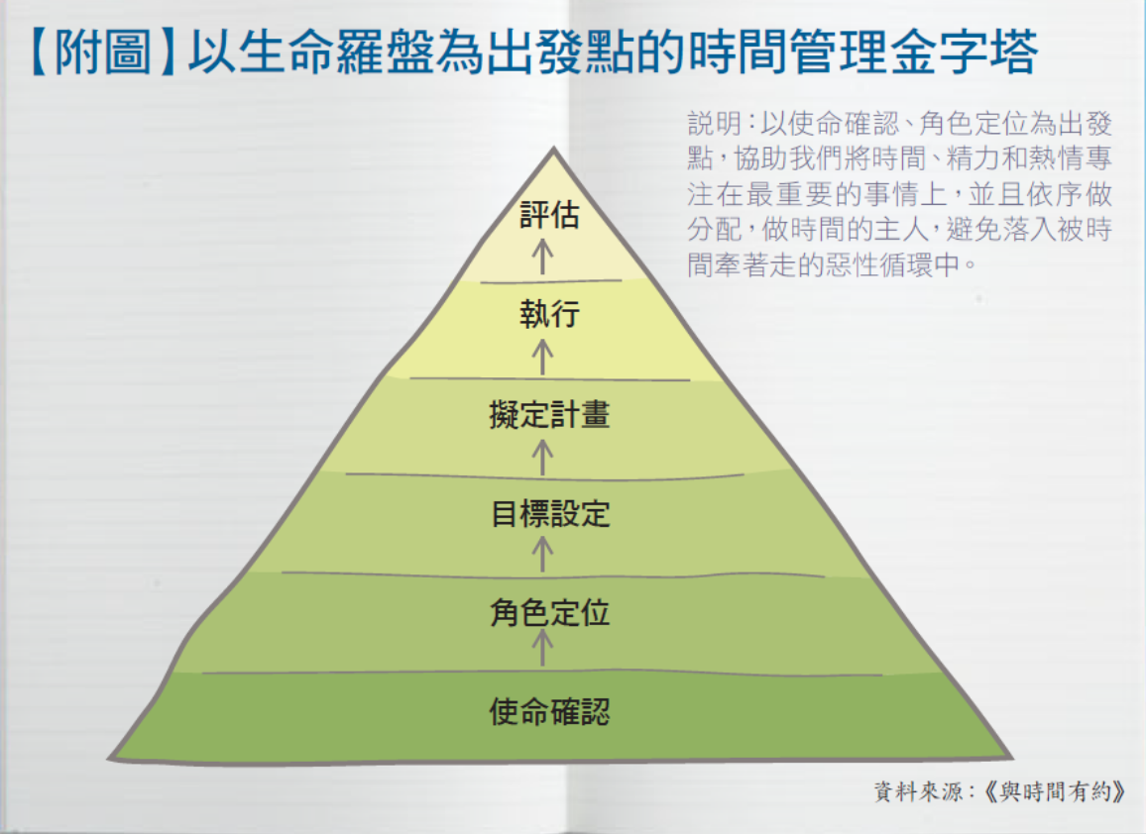

Slide 25
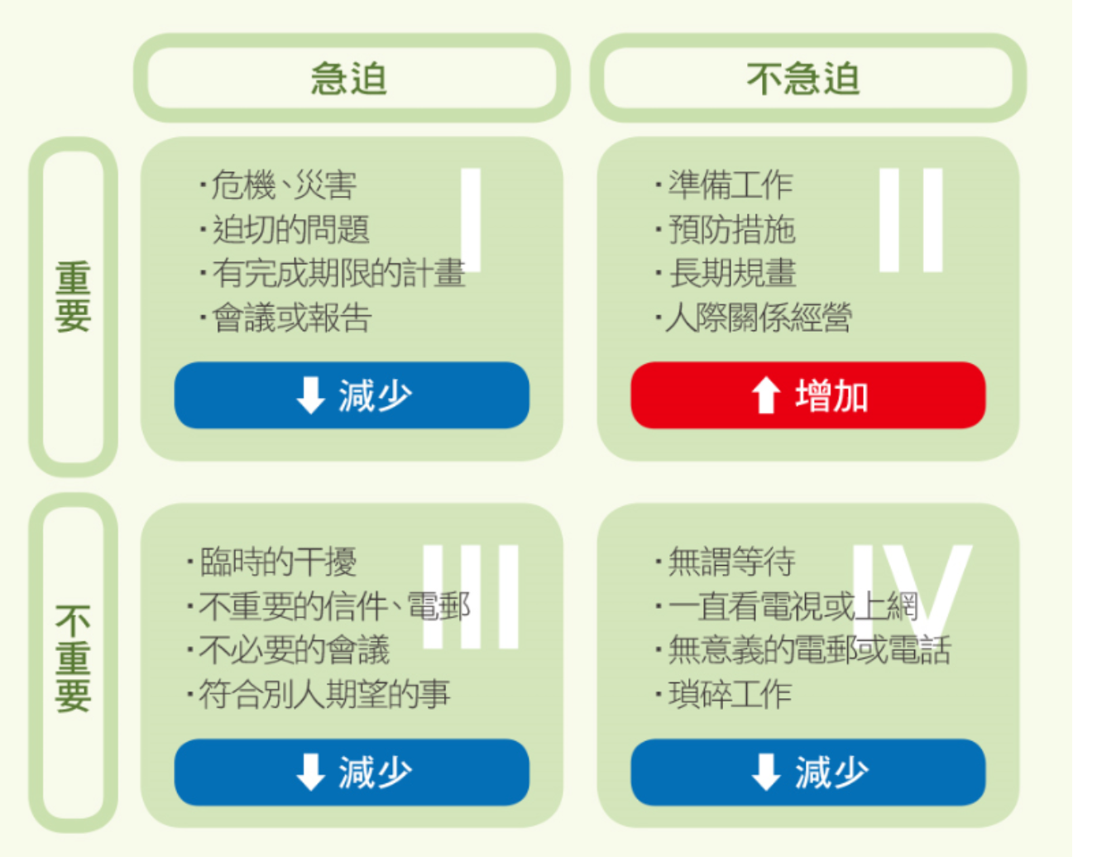

Slide 26
A Calendar View
 | Monday | Tuesday | Wednesday | Thursday | Friday | Saturday | Sunday
6am - 7am
7am - 8am |  | S | L | E | E | P
8am - 9am
9am - 10 am
10am - 11am | W | W | W | W | W
11am - 12pm | O | O | O | O | O
12pm - 1pm | R | R | R | R | R
1pm - 2pm | K | K | K | K | K
2pm - 3pm
3pm - 4pm
4pm - 5pm
5pm - 6pm
6pm - 7pm
7pm - 8pm | CORING |  |  | HBP
8pm - 9pm |  | PRD CALL
9pm - 10pm
10pm - 11pm
11pm - 12am |  | S | L | E | E | P

Slide 27
Monday | Tuesday | Wednesday | Thursday | Friday | Saturday | Sunday
Audio | Audio | Audio | Audio | Audio | Audio | Wake up Later
Working | Working | Working | Working | Working | Working | Church/ Household
Lunch/Prospecting | Lunch/Prospecting | Lunch/Prospecting | Lunch/Prospecting | Lunch/Prospecting | Lunch | Lunch
Working | Working | Working | Working | Working | RPA/ Personal Time | RPA/ Personal Time
Coring | Prospecting/ Product Call | UBP/ Prospecting | Zoom Coring Prospecting | Family Bonding | Team Bonding | Family Bonding
Note: MA requires : 8 – 15 hours per week
Plan in advance, quarter to quarter

Slide 28
Time Management : Sit Down Meeting ( 1 on 1/ 2 on 1)
Time Management: Using Events
Task Share business: 2 hrs – sit down meeting 1 Prospect
Share Products : 1 hrs – sit down Meeting 1 Prospect
Tickets : Bought 1
Duplicate/Delegate – 10 UFO
Share business: 20 hrs – sit down meeting 10 Prospect
Share Products : 10 hrs – sit down Meeting 10 Prospect
Tickets : Bought 10
Total Exposure:
Business: 10 Product: 10
Leverage Time Per GMTSS LOCAL : 10x8hr = 80 hrs
Task Share business: 2 hrs – HBP (5 Prospect)
Share Products : 1 hrs – PRODUCT EVENTS (5 Prospect)
Tickets : Bought 3
Duplicate/Delegate – 10 UFO
Share business: 20 hrs – HBP – 50 Prospect
Share Products : 10 hrs – PRD Event – 50 Prospect
Tickets : Bought 30
Total Exposure:
Business: 50 Product: 50
Leverage Time Per GMTSS LOCAL : 30x8hr = 240 hrs

Slide 29
Time Management : Sit Down Meeting ( 1 on 1/ 2 on 1)
Time Management: Using Events
Growth Factor ( 10 – 4 – 1) 1st Quarter: 10 UFO
Share business: 2 hrs – sit down meeting 10 Prospect TIME SPEND: 20hrs
Share Products : 1 hrs – sit down Meeting 10 Prospect TIME SPEND: 10hrs
Tickets : Bought 10
YOU PUT IN 3 HRs
2nd Quarter : 11UFO ( New Sponsor: 1)
Share business: 2 hrs – sit down meeting 11 Prospect :22 hrs
Share Products : 1 hrs – sit down Meeting 11 Prospect : 11 hrs
Tickets : Bought 1 = 11 Tickets YOU PUT IN 3 HRs
3rd Quarter : 12 UFO ( New Sponsor: 1)
Share business: 2 hrs – sit down meeting 12 Prospect :24 hrs
Share Products : 1 hrs – sit down Meeting 12 Prospect : 12 hrs
Tickets : Bought 1 = 12 Tickets YOU PUT IN 3 HRs
4th Quarter : 13 UFO ( New Sponsor: 1)
Share business: 2 hrs – sit down meeting 13 Prospect :24 hrs
Share Products : 1 hrs – sit down Meeting 13 Prospect : 12 hrs
Tickets : Bought 1 = 13 Tickets YOU PUT IN 3 HRs
Leverage Time Per GMTSS LOCAL : 13x8hr = 104 hrs
Tickets 10
Growth Factor ( 10 – 4 – 1) 1st Quarter: 10 UFO
Share business: 2 hrs – HBP: 50 Prospect : 20 hrs
Share Products : 1 hrs – Product 50 Prospect: 10rs
Tickets : Bought 30 YOU PUT IN 3 HRs
2nd Quarter 2: 15 UFO ( New Sponsor: 5)
Share business: 2 hrs – HBP: 75 Prospect : 30hr
Share Products : 1 hrs – Product 75 Prospect:15 hrs
Tickets : Bought 1 = 45 Tickets YOU PUT IN 3 HRs
3rd Quarter : 22 UFO ( New Sponsor: 7)
Share business: 2 hrs – HBP :110 Prospect: 44 hr
Share Products : 1 hrs – Ptoduct: 110 Prospect 22 hrs
Tickets : Bought 1 = 66 Tickets YOU PUT IN 3 HRs
4th Quarter : 33 UFO ( New Sponsor: 11)
Share business: 2 hrs – HBP: 165 Prospect: 66 Hrs
Share Products : 1 hrs – Product: 165 Prospect: 33 hrs
Tickets : Bought 1 = 99 Tickets
YOU PUT IN 3 HRs
Leverage Time Per GMTSS LOCAL : 33x8hr = 792 hrs
Tickets 99

Slide 30
Pitfalls （陷阱、缺陷）
Work Hard they don’t work smart
I can achieve my goals on what I feel like doing
EGO – Me Me Me
Skillset
Not being able to identify sit down meet time vs social time
Scheduling: not logging and no calendar
Talking too much or taking too long on the appointment
Bundle Time
Social: Where business and social combine
Leverage: Learning to work your legs
Focus on anything but what you need to do
No Planning

Slide 31
Team Culture （团队文化）
Weekly Coring – Personal & Team Development – 2 hrs
TEAM Weekly HBP – Leverage Time RPA – 2hrs
Product Call – Helps 1 hr weekly Customers/UFO Management
We have 3 to 5 hrs a weekly left

Slide 35
Have a mindset of a Successful Entrepreneur. Time is valued more then Money. Handle time with the Significance Approach!

